Slide 1
GROUP 4 PROJECT 2
ACHARYA AKHILESH GIRISH
DENNIS CHEN CHEE HAO
MA JIAN SCHAUN

Slide 2
PROBLEM
Using the Dijkstra's algorithm, we want to find out how the following affects its time complexity:
Adjacency Matrix + Array Priority Queue
VS
b) Adjacency List + Min Heap Priority Queue

Slide 3
(a) Suppose the input graph G = (V, E) is stored in an adjacency matrix and we use an array for the priority queue.
Implement the Dijkstra’s algorithm using this setting and analyze its time complexity with respect to |V| and |E| both theoretically and empirically.

Slide 4
Theoretical time complexity of Dijkstra's Algorithm with graph being represented as an adjacency matrix and priority queue as an unordered list (normal array)
function Dijkstra(Graph, source):
for each vertex v in Graph.Vertices: . . . .
dist[v] ← INFINITY . Initialization - happens for all vertices
prev[v] ← UNDEFINED . in O(|V|)
add v to Q . . . . . . . . . . . . . . .
dist[source] ← 0 . . . . . . . . . . . . . . Happens in constant time O(1)
while Q is not empty:. . . . . . . . . . . . When all vertices in graph been visited, O(|V|)
u ← vertex in Q with min dist[u]. . . . Go through all the elements in array to determine min, O(|V|)
remove u from Q . . . . . . . . . . . . Happens in constant time O(1)
for each neighbor v of u still in Q:. . Maximum of V-1 other neighbours for each vertex
alt ← dist[u] + Graph.Edges(u, v) .
if alt < dist[v]: . To relax the neighbours here would
dist[v] ← alt . constant time O(1)
prev[v] ← u. . . . . . . . . .
return dist[], prev[]
Time Complexity: O(|V|²)

Slide 5
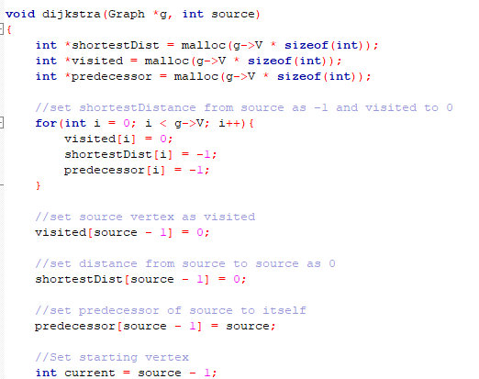
Implementation of Dijkstra's Algorithm 1
Initialization of Dijkstra’s Algorithm

Slide 6
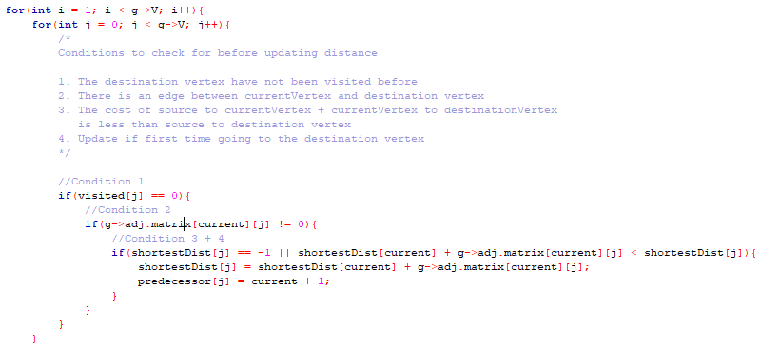
Implementation of Dijkstra's Algorithm 1
Relaxing the neighbours from the vertex visited

Slide 7
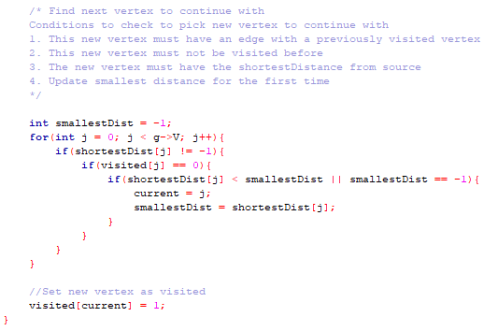
Implementation of Dijkstra's Algorithm 1
Choosing the new vertex with the minimum distance

Slide 8
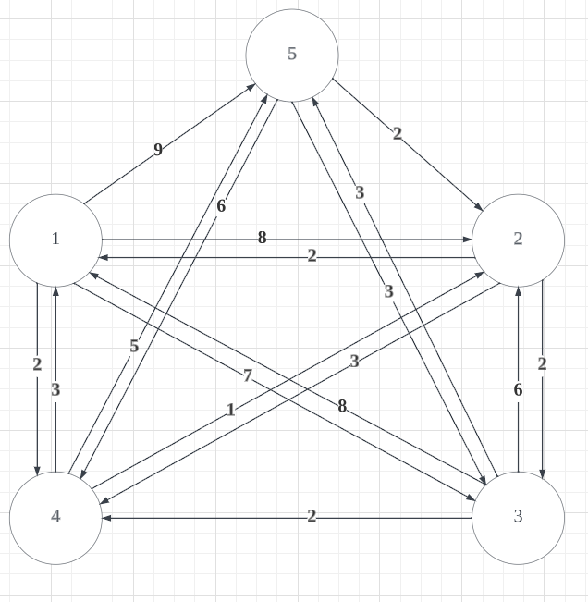
ADJACENCY MATRIX VS LIST
Adjacency Matrix:
[[0 8 7 2 9]
[2 0 2 3 0]
[8 6 0 2 3]
[3 1 0 0 5]
[0 2 3 6 0]]
Adjacency List:
1: 2(8) -> 3(7) -> 4(2) -> 5(9) ->
2: 1(2) -> 3(2) -> 4(3) ->
3: 1(8) -> 2(6) -> 4(2) -> 5(3) ->
4: 1(3) -> 2(1) -> 5(5) ->
5: 2(2) -> 3(3) -> 4(6) ->

Slide 9
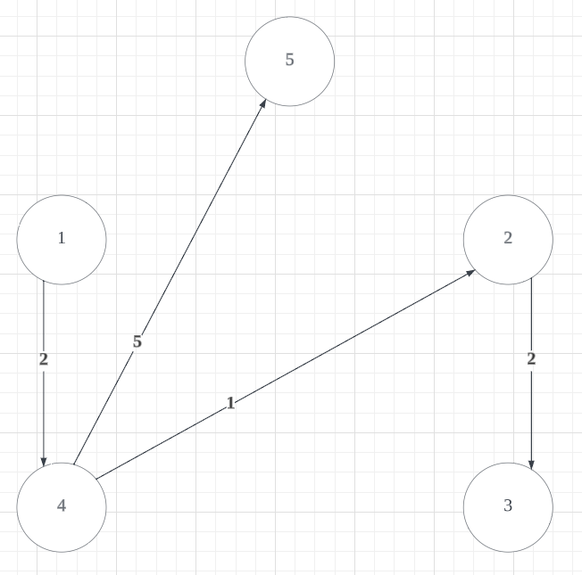
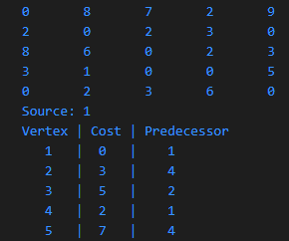
ADJACENCY MATRIX

Slide 10
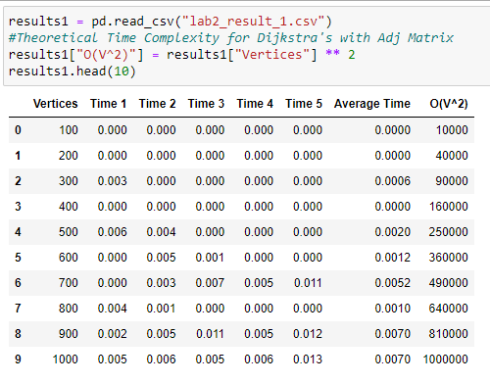
Collection of Empirical Data of Dijkstra’s Algorithm 1
We will be collecting the run time for Dijkstra's Algorithm.
We have generated a complete graph ranging from 100 to 4000 vertices with interval of 100.
For each graph size, we will be generating 5 different graphs and collecting 5 timings and taking the average
Created a new column for the theoretical time complexity

Slide 11
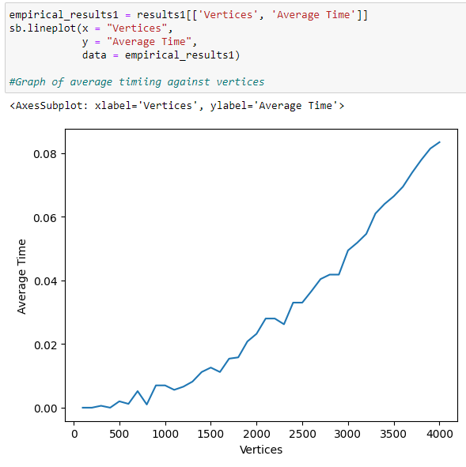
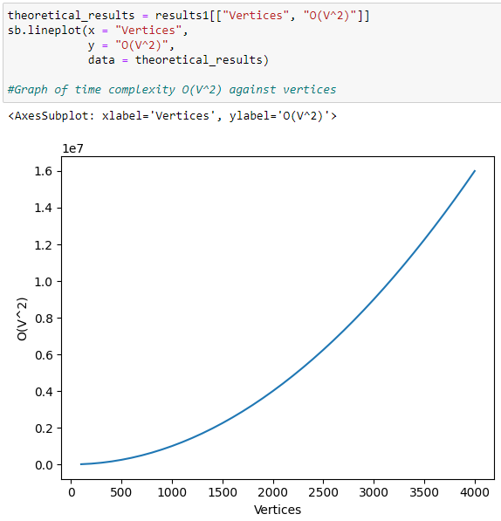
Plotting of graphs, and comparing them
As we can see from the 2 graphs, the shape of the two graphs is very similar.
So next we will check the correlation between time complexity and average run time of our implementation
So in order to determine whether our algorithm implementation is accurate, we will first plot a graph of average timing against vertices and compare it with the theoretical time complexity against vertices.

Slide 12

Analysis and correctness of our implementation
Since the correlation of 0.998 is extremely close to 1, this suggests that there is almost a perfect linear relationship between average run time of our implementation and the theoretical time complexity.
This suggests to us that our implementation is more likely to be correct.

Slide 13
(b) Suppose the input graph G = (V, E) is stored in an array of adjacency lists and we use a minimizing heap for the priority queue.
Implement the Dijkstra’s algorithm using this setting and analyze its time complexity with respect to |V| and |E| both theoretically and empirically.

Slide 14
Theoretical time complexity of Dijkstra's Algorithm with graph being represented as an adjacency list and min heap as priority queue
function Dijkstra(Graph, source):
for each vertex v in Graph.Vertices: . . . . Initialization - happens for all vertices in O(|V|)
dist[v] ← INFINITY . . . . . . . . . . . Happens in constant time O(1)
prev[v] ← UNDEFINED . . . . . . . . . . Happens in constant time O(1)
add v to Q . . . . . . . . . . . . . . . Building heap, takes O(log|V|)
dist[source] ← 0 . . . . . . . . . . . . . . Happens in constant time O(1)
while Q is not empty:. . . . . . . . . . . . Can happen for all edges in the graph O(|E|)
u ← vertex in Q with min dist[u]. . . . Removing min from heap, takes O(log|V|)
remove u from Q . . . . . . . . . . . . Happens in constant time O(1)
for each neighbor v of u still in Q:
alt ← dist[u] + Graph.Edges(u, v)
if alt < dist[v]:
dist[v] ← alt
prev[v] ← u
return dist[], prev[]
Time Complexity:
O(|V|log|V|) + O(|E|log|V|) = O((|V| + |E|) * log|V|)

Slide 15
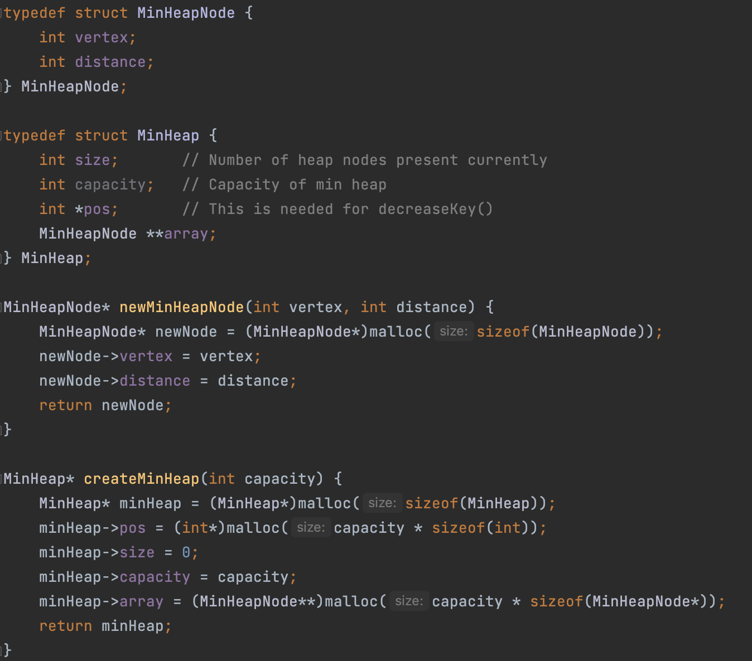
Implementation of Dijkstra's Algorithm 2
Structure of the MinHeap

Slide 16
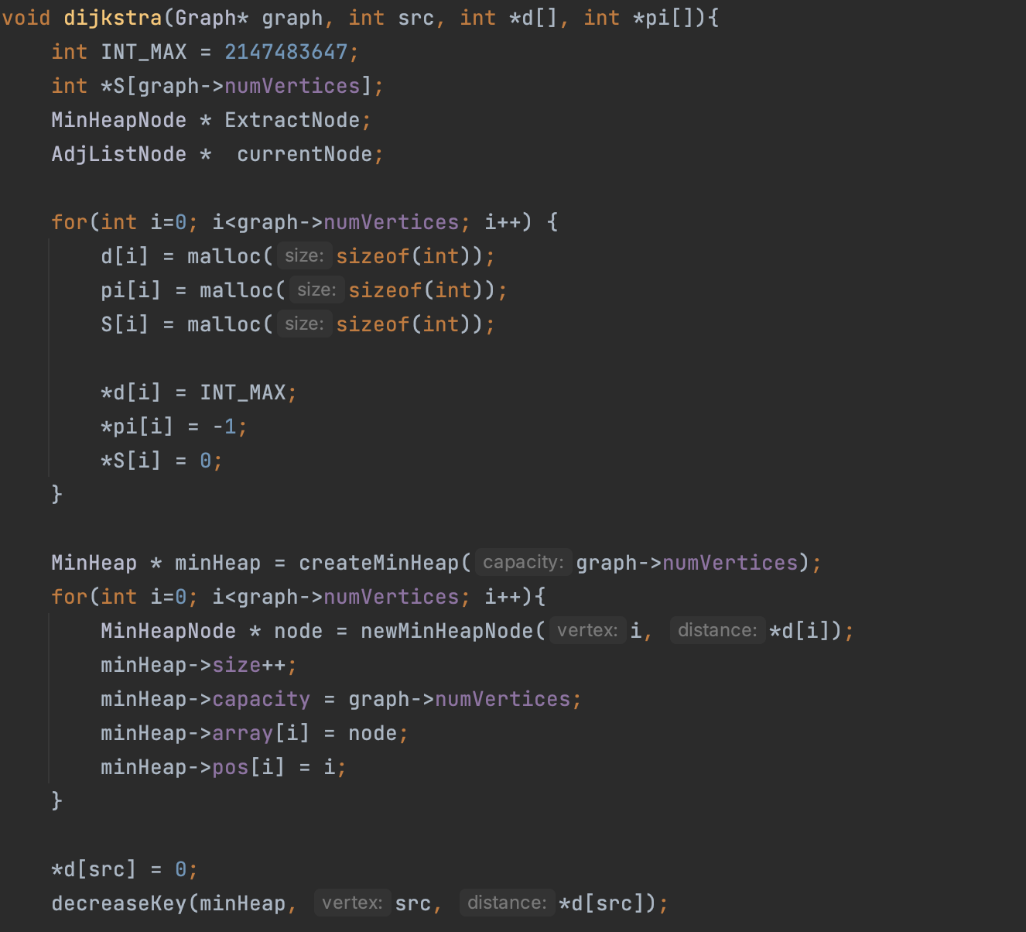
Implementation of Dijkstra's Algorithm 2
Initialization of Dijkstra’s Algorithm

Slide 17
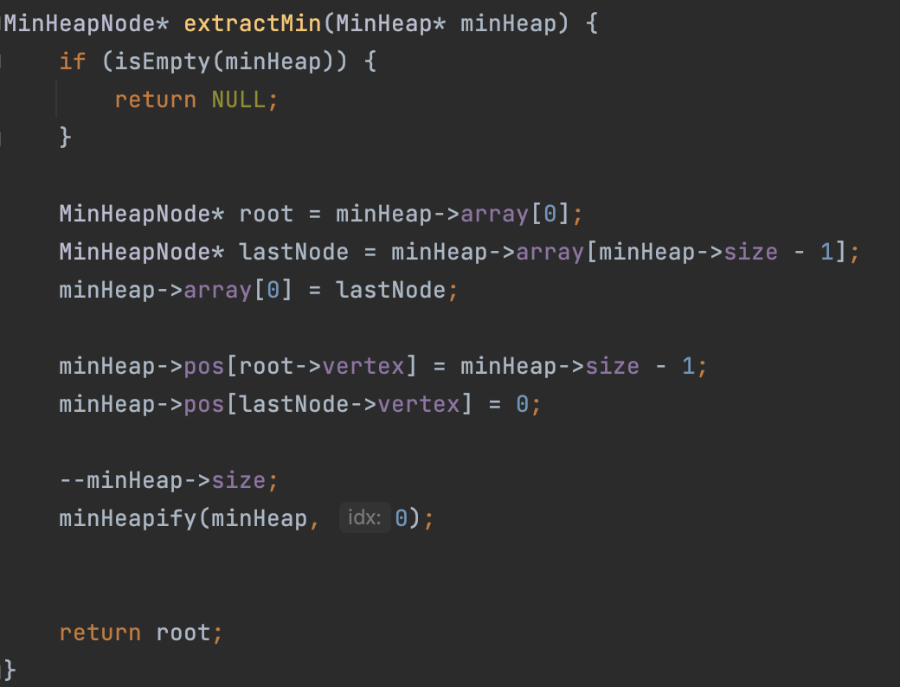
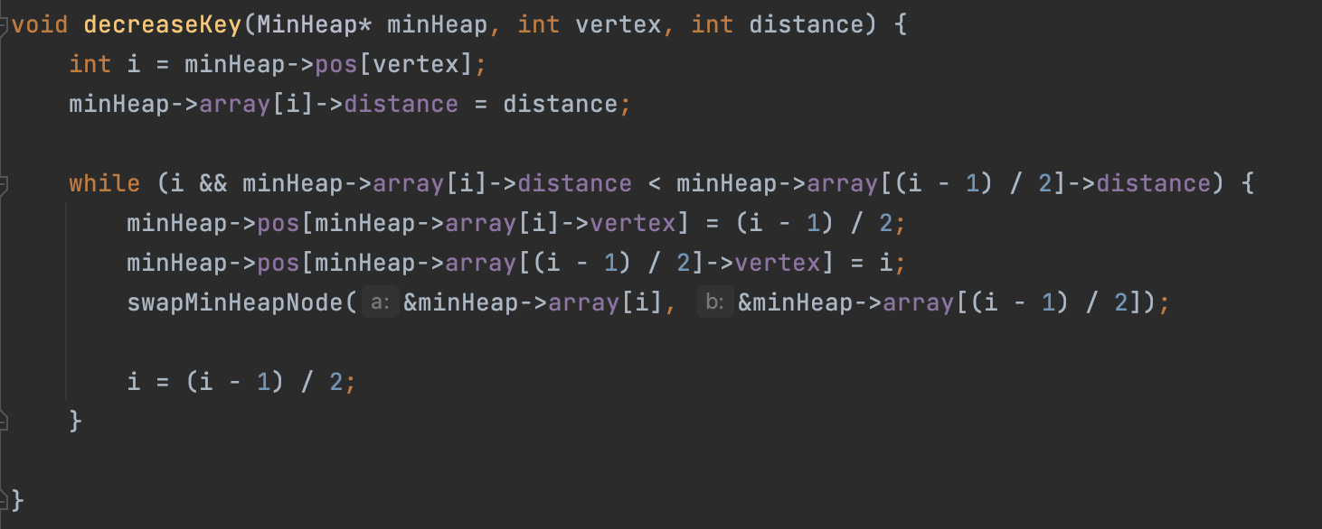
Implementation of Dijkstra's Algorithm 2

Slide 18
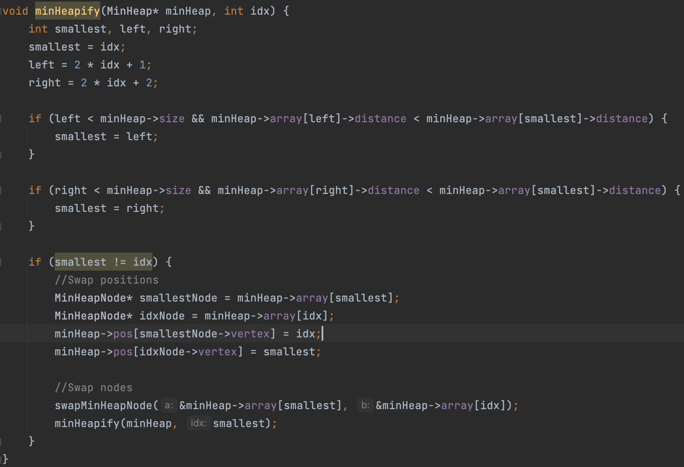
Implementation of Dijkstra's Algorithm 2

Slide 19
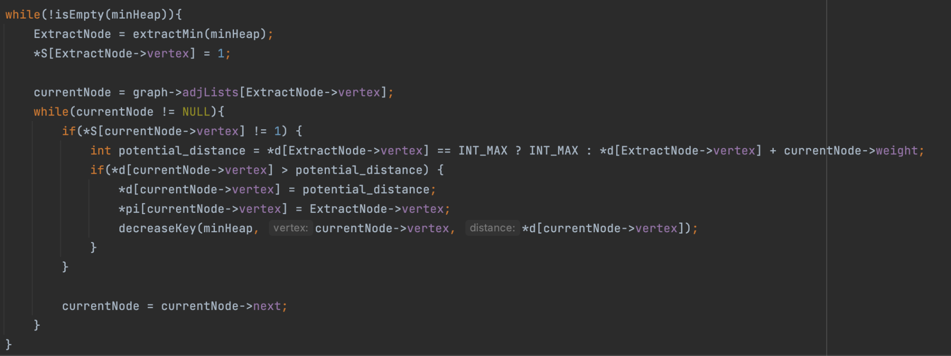
Implementation of Dijkstra's Algorithm 2
Relaxing the neighbours from the vertex visited

Slide 20
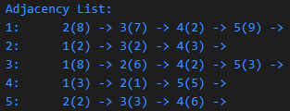
ADJACENCY LIST

Slide 21
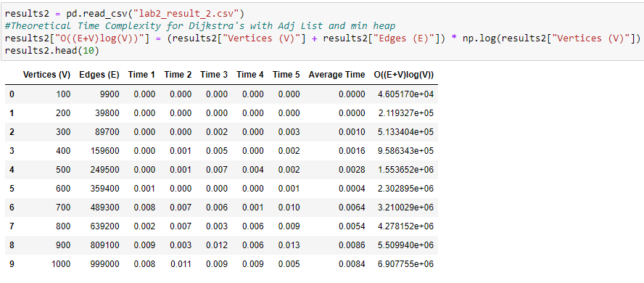
Collection of Empirical Data of Dijkstra’s Algorithm 2
We will be collecting the run time for Dijkstra's Algorithm.
We have generated a complete graph ranging from 100 to 4000 vertices with interval of 100.
For each graph size, we will be generating 5 different graphs and collecting 5 timings and taking the average
Created a new column for the theoretical time complexity

Slide 22
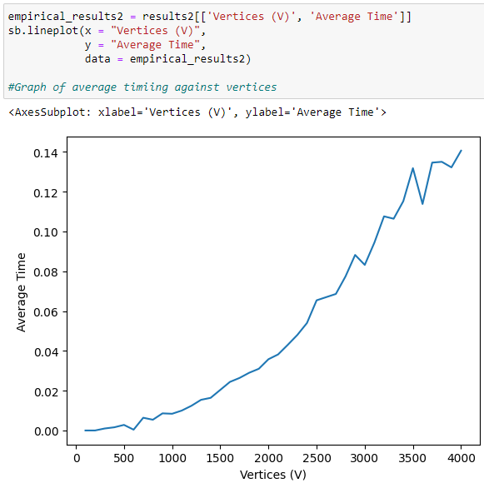
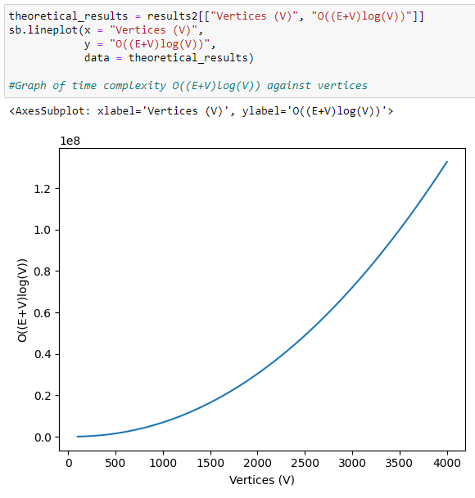
Plotting of graphs, and comparing them
Again, we can see from the 2 graphs, the shape of the 2 graphs is very similar.
So next we will check the correlation between time complexity and average run time of our implementation
So in order to determine whether our algorithm implementation is accurate, we will first plot a graph of average timing against vertices and compare it with the theoretical time complexity against vertices.

Slide 23

Analysis and correctness of our implementation
Since the correlation of 0.993 is extremely close to 1, this suggests that there is almost a perfect linear relationship between average run time of our implementation and the theoretical time complexity.
This suggests to us that our implementation is more likely to be correct.

Slide 24
(c) Compare the two implementations in (a) and (b).
Discuss which implementation is better and in what circumstances.
From the theoretical time complexity analysis in part 1 and 2, we know that Dijkstra with Adjacency Matrix only gets affected by the number of vertices, whereas Dijkstra with Adjacency List and min heap gets affected by both edges and vertices.
This suggests that we have to explore how different graph density will affect the runtime of Dijkstra's Algorithm.
What we did
Collect data on a graph of 2000 vertices with a range of edges
Collect data on different density of graphs over different number of vertices

Slide 25
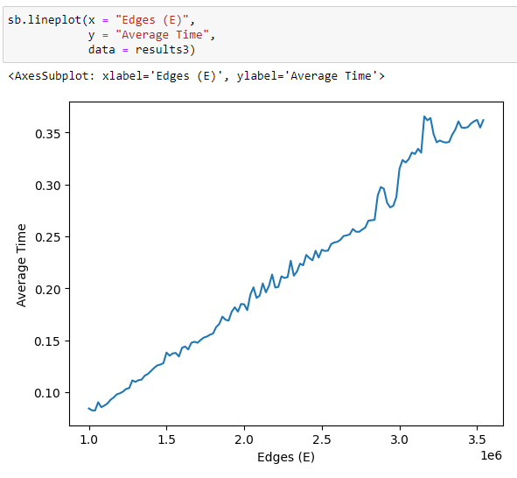
Graph of 2000 vertices, and range of edges
As we can see from the graph, as edges increases, the run time of dijkstra's algorithm also increased, which is to be expected from the theoretical time complexity.

Slide 26
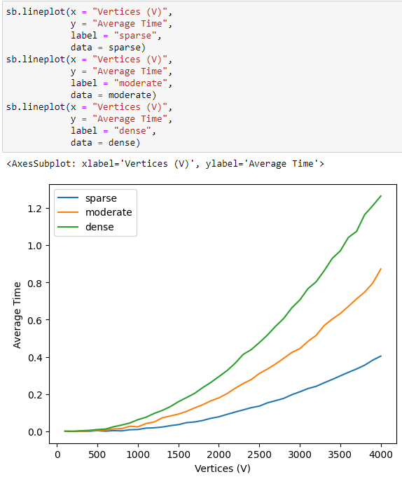
Different graph density over different vertices
Sparse -> 25% of max edges (25% of V²)
Moderate -> 50%
Dense -> 75%
So, as we can see from the graph, when the vertices are small, the density of the graph does not really affect the run time of the algorithm.
However, as vertices increases, the denser a graph, the faster the run time will rise.

Slide 27
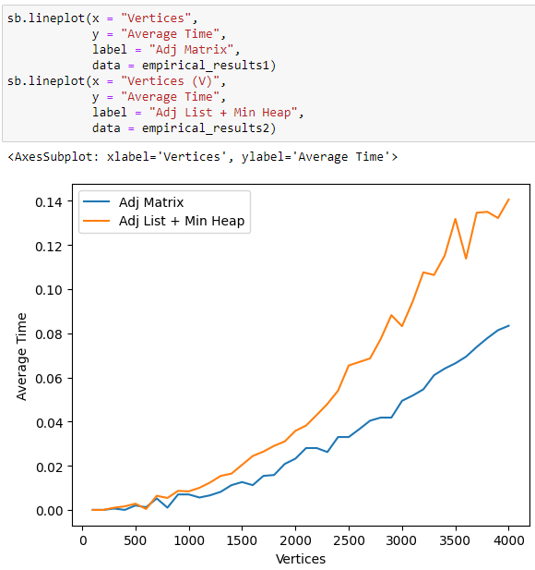
Comparing Adj Matrix and Adj List implementations
So as we can see, on a complete graph, dijkstra with adjacency matrix actually performs better than adjacency list and min heap.
A possible reason as to why adjacency matrix performs better is that in a complete graph, the number of heap operations that need to be done is a lot since we have to consider all edges.
And performing so many heap operations can be more time-consuming than accessing the weight of any edge between two vertices in an adjacency matrix which happens in constant time.

Slide 28
Conclusion about Dijkstra’s Algorithm
To conclude
1. When number of vertices in graph is small, which implementation to use does not matter as much
2. When number of vertices in graph is big, but graph density is low, use dijkstra's algorithm with adjacency list with min heap
3. When number of vertices in graph is big, but graph density is high, use dijkstra's algorithm with adjacency matrix

Slide 29
Thank you!

